Slide 1
Strategic Plan Update
Board of Education
Theme: Support and develop UCPS Employees
Strategic Initiative: 1a.Develop a 5-year recruitment and hiring plan to maintain a workforce of effective and qualified professionals
Executive Sponsor – Dr. Chris Barnes
Initiative Owner – Dr. Tom Bulla

Slide 2
Strategic Theme
Support and develop UCPS employees

Slide 3
Strategic Initiative
1a. Develop a five-year recruitment and hiring plan to maintain a workforce of effective and qualified professionals

Slide 4
Previous STATE
Career Fairs
Mentor Programs
Professional Development
Targeted Bonuses
UCPS Teacher of the Year
UCPS Employee of the Month

Slide 5
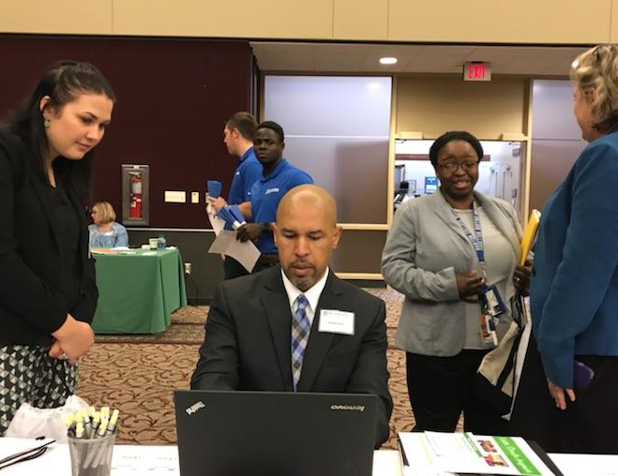
Desired STATE
5-Year Recruitment Plan
Career Fair Expansion
Comprehensive Compensation Plan
University Partnership
Enhanced Targeted Bonuses
Hire Forward Initiative
UCPS Interview Protocol

Slide 6
PERFORMANCE INDICATORS from sec. VIII
Year 1
Performance Indicator | Measurement Method | Targeted Achievement
Create 5 year recruitment and hiring plan | 5 year recruitment plan | Plan has measurable and articulated goals for recruitment and hiring
Hire Compensation Specialist | Market analysis from Compensation Specialist | Create salary schedules commensurate with applicable marketplace jobs
Participate in local, state and national job fairs | Determine number of f2f contacts and number of candidates interviewed, offered and hired. | Reduce the number of posted vacancies in both certified and non-certified areas
Plan, develop and initiate Teacher Assistant to Teacher program | Memorandum of Agreement with Universities to support programming | Assess the number of interested UCPS staff that participate in the offered programs.
Plan, develop and initiate the Teacher to Administrator Program | Memorandum of Agreement with Universities to support programming | Assess the number of interested UCPS staff that participate in the offered programs.

Slide 7
TIMELINE from VII
 | Advancing degree program with university partnerships (Wingate/UNCC, etc.) -TA to T Program -T to Admn Program -UCPS Teaching Fellows Program | -UCPS Representatives -University contacts -Identified UCPS Staff | 11/2017 | On-going
 | Introduce new interview protocol- “Hire Forward” to screen applicants for principals | -UCPS HR Staff -Principals | 10/2017 | On-going
 | Focus on development and support of BT 1s, 2s, and 3s | -UCPS HR Staff -UCPS Teaching and Learning | 11/2017 | On-going
 | Create new employee marketing plan to utilize a variety of digital tools to enhance communication with prospective applicants | -UCPS HR Staff -UCPS Communications Dept. - | 1/2018 | On-going
Action Item # | Milestone Deliverable or Activity |  | Proposed Start Date | Proposed Due Date
 | Development of 5 year recruitment and hiring plan to maintain a workforce of effective and qualified professionals | -HR Staff | 11/2017 | January, 2018
 | Review current onboarding procedures and develop: a) survival guide, b) FAQ, and c) enhanced Frontline Central services. Request input from recently hired UCPS staff. | -UCPS Human Resources/Finance department for benefits and hiring -Other | 10/2017 | January, 2018 (Survival Guide)
 | Enhance Mentor Training Program | -HR Representatives -Lead UCPS Mentors (stipend) -Possible mentor | 11/2017 | On-going
 | Plan, Implement and Articulate Career Fairs for attaining the most highly qualified candidates -Hire Forward -Targeted Recruitment -Compensation Specialist | -HR Representatives -Administrative reps -Auxiliary Services reps | 11/2017 | On-going (Fall/Spring)

Slide 8
QUESTIONS?

Slide 9
TIMELINE
Completed
In progress
Not yet started
Milestone Deliverable or Activity | Progress
Create 5-year recruitment and hiring plan
Hire Compensation Specialist
Participate in local, state and national job/career fairs
Plan, develop and initiate Teacher Assistant to Teacher Program
Plan, develop and initiate the Teacher to Administrator Program

Slide 10
TIMELINE
Completed
In progress
Not yet started
Milestone Deliverable or Activity | Progress
Enhance Mentor Training Program
Begin Hire Forward Initiative
Focus development and support of Beginning Teachers (1s, 2s, 3s)
Create marketing plan to enhance communication with prospective applicants

Slide 11
CURRENT/DESIRED STATE from sec III
Currently, a variety of activities are utilized to support the recruitment efforts. To attain prospective employees, recruitment efforts include participation in University Careers fairs, locally sponsored Career Fairs and outreach to local universities to increase awareness of student teachers. To retain employees, we have a mentor program that supports teachers new to the profession and new to Union County. In addition, professional development is offered to support teacher development. Targeted bonuses exist as well as some forms of employee recognition (UCPS TOY and UCPS Employee of the Month).

